Slide 1
Technology Trends Analysis Report
Mark Cris Marqueses
IBM Data Analyst Capstone Project
2025

Slide 2
Table of contents
01
05
02
08
Executive Summary
Database Trends
Introduction
06
Dashboard Overview
03
Methodology
07
Insights and Findings
04
Programming Language Trends
Conclusion

Slide 3
Executive Summary
01
This project analyzes current and future technology trends using survey data. Dashboards were built in IBM Cognos Analytics to visualize programming languages, databases, platforms, web frameworks, and demographics to support data-driven insights

Slide 4
02
Introduction
Purpose: Analyze technology usage and future trends
Audience: Aspiring data professionals and decision-makers.
Value: Provides insights into in-demand technologies and workforce demographics.

Slide 5
Methodology
03
Data Source: survey_data_updated.csv
Collection: Developer survey responses
Wrangling: Removed duplicates, handled missing values, split multi-value fields using delimiter(;).
Tool Used: IBM Cognos Analytics

Slide 6
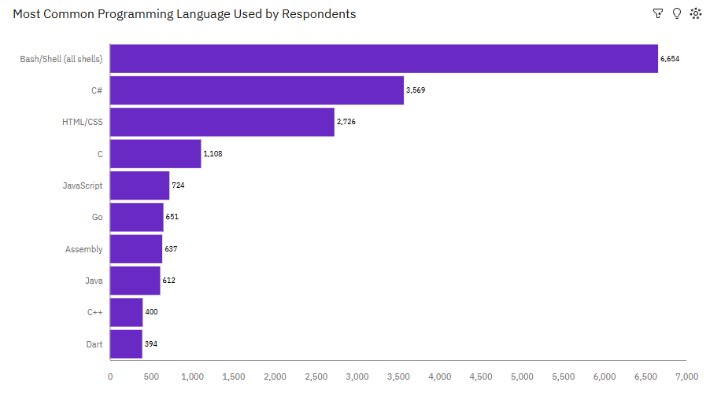
Programming Language – Current Usage
04
Bar chart shows the Top 10 programming languages currently used by respondents.
Key Insight: Bash/Shell, C#, and HTML/CSS dominate current usage.

Slide 7
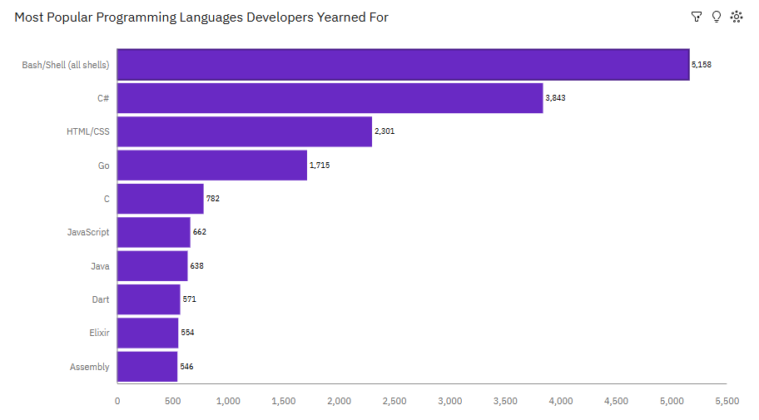
Programming Language – Future Trend
Visualization highlights programming languages developers want to learn or use next.
Implication: Demand is shifting toward modern and versatile languages.

Slide 8
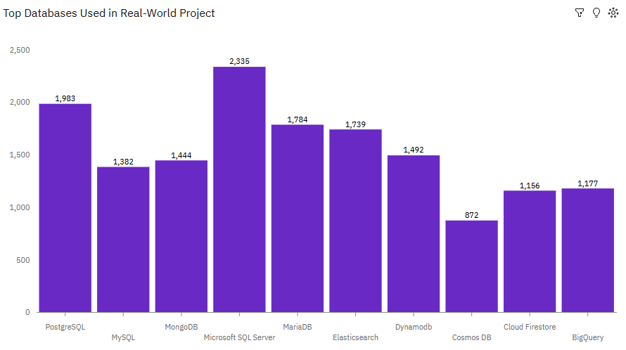
Database Trends – Current Usage
05
Bar chart summarizes the Top 10 databases used in real-world projects.
Insight: SQL-based databases remain highly relevant.

Slide 9
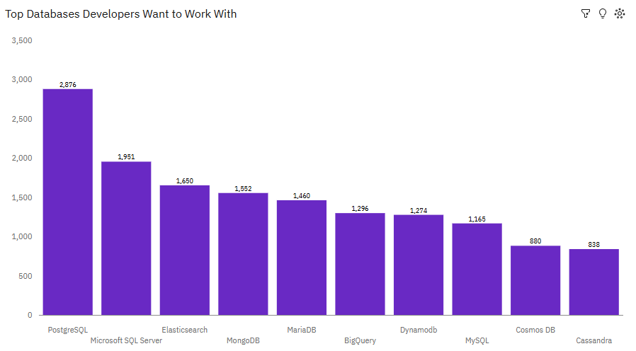
Database Trends – Future Demand
Visualization shows databases developers want to work with in the future.
Implication: Cloud-native and scalable databases are gaining popularity.

Slide 10
Dashboard Overview
06
Three interactive dashboards were created using IBM Cognos Analytics:
Current Technology Usage
Future Technology Trends
Demographics

Slide 11
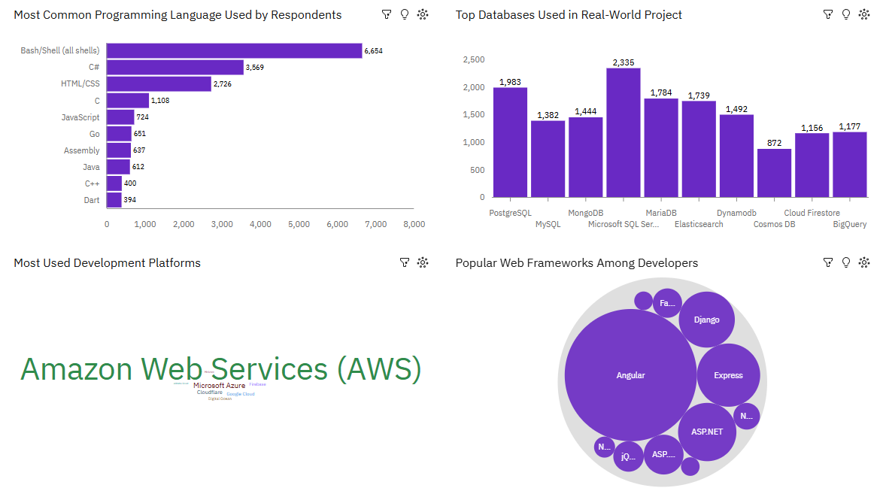
Dashboard: Current Techmology Usage

Slide 12
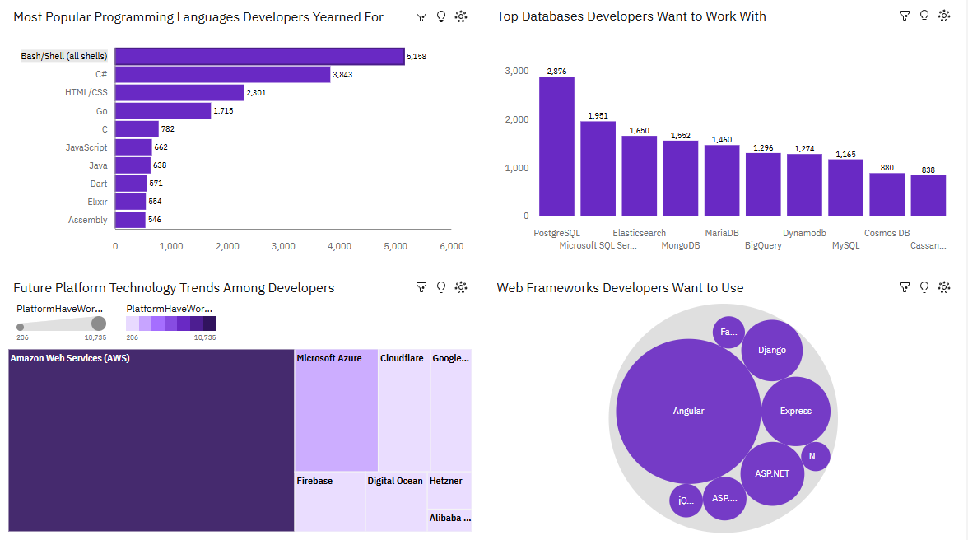
Dashboard: Future Techmology Trends

Slide 13
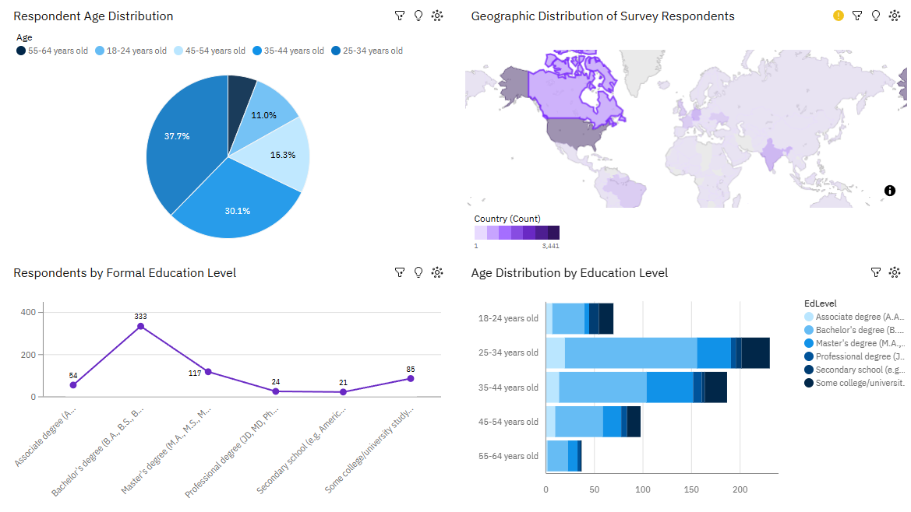
Dashboard: Demographics

Slide 14

Insights from Dashboards
07
AWS dominates platform usage.
Angular and Express lead web framework interest.
Most respondents are aged 25–44 with bachelor’s degrees.

Slide 15
Overall Findings and Implications
Technology trends indicate strong demand for cloud platforms and modern frameworks.
These insights can guide learning paths and workforce planning.

Slide 16
Conclusion
08
The project successfully demonstrates how dashboards can transform raw data into actionable insights.
IBM Cognos Analytics proved effective for professional data visualization.

